Slide 1
OPERATION AND METRIC ANALYTICS
MENU
ANALYSIS
CONTACT
DATA ANALYSIS
Presented by:- Pushkar Raj

Slide 2
Description :
DATA ANALYSIS
Operational Analytics is a crucial process that involves analyzing a company's end-to-end operations. This analysis helps identify areas for improvement within the company. As a Data Analyst, you'll work closely with various teams, such as operations, support, and marketing, helping them derive valuable insights from the data they collect. One of the key aspects of Operational Analytics is investigating metric spikes. This involves understanding and explaining sudden changes in key metrics, such as a dip in daily user engagement or a drop in sales. As a Data Analyst, you'll need to answer these questions daily, making it crucial to understand how to investigate these metric spikes. In this project, you'll take on the role of a Lead Data Analyst at a company like Microsoft. You'll be provided with various datasets and tables, and your task will be to derive insights from this data to answer questions posed by different departments within the company. Your goal is to use your advanced SQL skills to analyze the data and provide valuable insights that can help improve the company's operations and understand sudden changes in key metrics.

Slide 3
Case Study 1: Job Data Analysis
DATA ANALYSIS
You will be working with a table named job_data with the following columns:
job_id: Unique identifier of jobs
actor_id: Unique identifier of actor
event: The type of event (decision/skip/transfer).
language: The Language of the content
time_spent: Time spent to review the job in seconds.
org: The Organization of the actor
ds: The date in the format yyyy/mm/dd (stored as text).
Tasks:
A. Jobs Reviewed Over Time:
Objective: Calculate the number of jobs reviewed per hour for each day in November 2020.
Your Task: Write an SQL query to calculate the number of jobs reviewed per hour for each day in November 2020.

Slide 4
Case Study 1: Job Data Analysis
DATA ANALYSIS
B. Throughput Analysis:
Objective: Calculate the 7-day rolling average of throughput (number of events per second).
Your Task: Write an SQL query to calculate the 7-day rolling average of throughput. Additionally, explain whether you prefer using the daily metric or the 7-day rolling average for throughput, and why.
C. Language Share Analysis:
Objective: Calculate the percentage share of each language in the last 30 days.
Your Task: Write an SQL query to calculate the percentage share of each language over the last 30 days.
D. Duplicate Rows Detection:
Objective: Identify duplicate rows in the data.
Your Task: Write an SQL query to display duplicate rows from the job_data table.

Slide 5
Case Study 2: Investigating Metric Spike
DATA ANALYSIS
You will be working with three tables:
users: Contains one row per user, with descriptive information about that user’s account.
events: Contains one row per event, where an event is an action that a user has taken (e.g., login, messaging, search).
email-events: Contains events specific to the sending of emails.
Tasks:
A. Weekly User Engagement:
Objective: Measure the activeness of users on a weekly basis.
Your Task: Write an SQL query to calculate the weekly user engagement.
B. User Growth Analysis:
Objective: Analyze the growth of users over time for a product.
Your Task: Write an SQL query to calculate the user growth for the product.

Slide 6
Case Study 2: Investigating Metric Spike
C. Weekly Retention Analysis:
Objective: Analyze the retention of users on a weekly basis after signing up for a product.
Your Task: Write an SQL query to calculate the weekly retention of users based on their sign-up cohort.
D. Weekly Engagement Per Device:
Objective: Measure the activeness of users on a weekly basis per device.
Your Task: Write an SQL query to calculate the weekly engagement per device.
E. Email Engagement Analysis:
Objective: Analyze how users are engaging with the email service.
Your Task: Write an SQL query to calculate the email engagement metrics.

Slide 7
PROJECT OVERVIEW
MENU
ANALYSIS
DATA ANALYSIS
This project focuses on Operational Analytics for a company like Microsoft, aiming to analyze job and user data to generate insights that improve company operations.
Job data analysis involves tracking job reviews over time, throughput analysis, language distribution, and identifying duplicate records in job data.
focuses on analysing sudden changes in user behaviour, such as spikes in user engagement or drops in retention. The analysis includes measuring weekly user engagement, tracking user growth, analysing retention trends, understanding device-specific engagement, and evaluating email interaction metrics.

Slide 8
PURPOSE OF THE PROJECT
DATA ANALYSIS
Analyze job data to optimize workflows and identify areas for improvement
Understand sudden changes in key metrics such as user engagement, retention, or growth of users and their engagement with email services
Provide actionable insights to operations, marketing, and support teams to inform strategic decisions
Detect duplicates and inconsistencies in job and user data to ensure accurate reporting and analysis

Slide 9
HANDLING THE ANALYSIS
DATA ANALYSIS
01
Data Cleaning and Prepration
Clean and prepare the datasets by addressing duplicates, formatting issues and missing values.
Job Data Analysis
02
Use SQL to calculate jobs reviewed over time, rolling averages for throughput and language distribution
03
Metric Spike Investigation
Track weekly user engagement, growth, retention and email engagement to identify spikes or trends

Slide 10

Approach to the project
DATA ANALYSIS
Understanding the business context means grasping the company's goals, dataset purposes, and departmental questions to tailor the analysis effectively
01
Data cleaning and preparation involve removing duplicates, handling missing values, and ensuring consistent formats for accurate analysis
02
In structured analysis, I use SQL to perform tasks like aggregations, rolling averages, and complex calculations to derive insights from the data
03
04
For exploratory investigation, I analyze trends and compare metrics to identify anomalies and sudden changes
Deriving actionable insights involves interpreting the results and providing clear recommendations to address business needs.
05

Slide 11
Execution to the analysis
DATA ANALYSIS
03
02
Metric Spike Investigation
I measured weekly user activity by counting unique users and analyzed sign-ups and cohort retention to identify engagement patterns and product growth
I measured device-specific user activity and analyzed email interactions to assess engagement and email campaign effectiveness.
01
Job Data Analysis
Data Cleaning
I used SQL to aggregate job reviews per hour and day, calculate daily throughput, and apply a 7-day rolling average to identify trends, smooth fluctuations, and capture long-term performance metrics.
Determined the language share in job data over the past 30 days to reveal usage trends.
Ensure data quality by removing duplicates, handling missing values, formatting dates correctly and maintaining column consistency for reliable analysis

Slide 12
HANDLING THE ANALYSIS
DATA ANALYSIS
Ensure data quality by removing duplicates, handling missing values and formatting dates correctly
Venus is the second planet from the Sun
Earth is the third planet from the Sun
Data cleaning and prepration
Job reviewed over time
Throughput & Language
Share Analysis
01
02
03
05
04
jupiter
mars
Jupiter doesn’t have a solid surface
Despite being red, Mars is very cold

Slide 13
TECH STACK USED : MySQL Workbench (8.0)
DATA ANALYSIS
The built-in SQL editor and visual tools made it easier to import CSV files, explore the table schema, and run complex queries for analysis
01
02
It allowes efficient execution of JOINs, aggregations, window functions, and time-based filtering which were critical for deriving insights
03
It offers an intuitive graphical interface for writing and running SQL queries

Slide 14
INSIGHTS
DATA ANALYSIS
Jobs Reviewed Over Time
01
Peak reviews were from 10 AM–2 PM; weekends showed low activity.
04
Duplicate Rows
Throughput
Duplicate rows found—likely from logging issues. Cleaning needed for accurate analysis.
02
The 7-day average showed smoother, more reliable throughput trends than daily data.
Case Study 1:
Job Data Analysis
Language Share
03
English led with 65%+ share; Spanish and French followed—highlighting a chance to improve support for non-English users.

Slide 15
INSIGHTS
DATA ANALYSIS
04
Weekly User Engagement:
Engagement by Device
Active users rose steadily, spiked briefly, then dipped—likely due to a temporary campaign or feature.
01
Mobile had higher engagement than desktop—emphasizing the need for a mobile-first focus.
User Growth
Email Engagement
05
02
Signups grew steadily, with spikes likely tied to product launches or campaigns.
Product update emails had ~45% opens; promos lagged at ~18%—pointing to a need for better targeting.
Case Study 2:
Investigating Metric Spike
Weekly Retention
03
Retention fell after Week 1, with ~30% active by Week 2—suggesting onboarding or value issues.

Slide 16
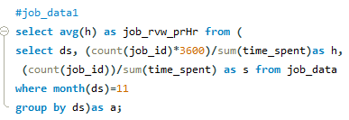

the number of jobs reviewed per hour for each day in November 2020
ANALYSIS
DATA ANALYSIS

Slide 17

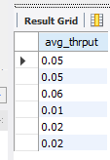
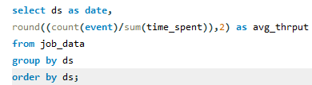
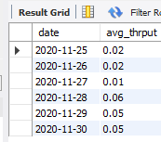
the 7-day rolling average of throughput
ANALYSIS
DATA ANALYSIS

Slide 18
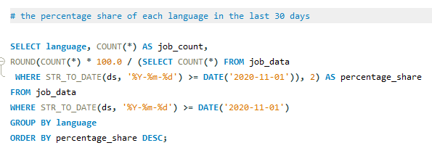
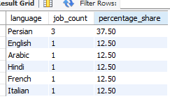
percentage share of each language in the last 30 days
ANALYSIS
DATA ANALYSIS

Slide 19


Duplicate Rows Detection
ANALYSIS
DATA ANALYSIS

Slide 20
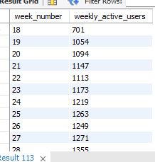
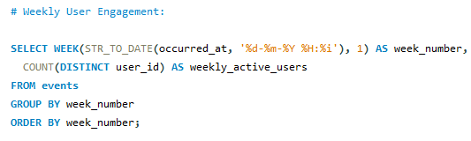
Weekly User Engagement
DATA ANALYSIS

Slide 21
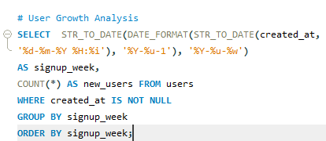
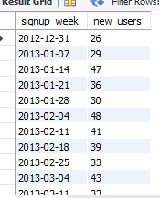
User Growth Analysis
DATA ANALYSIS

Slide 22
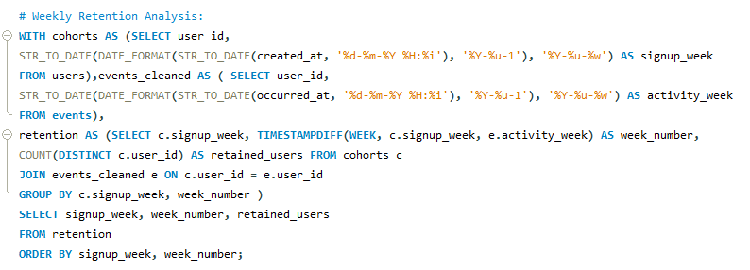
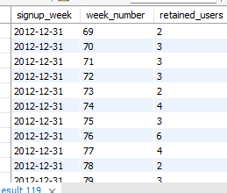
Weekly Retention Analysis
DATA ANALYSIS

Slide 23
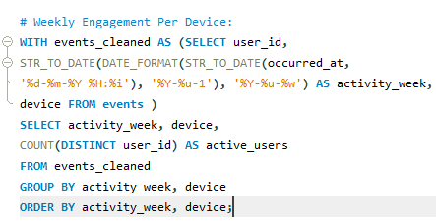
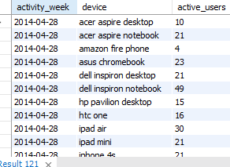
Weekly Engagement Per Device
DATA ANALYSIS

Slide 24
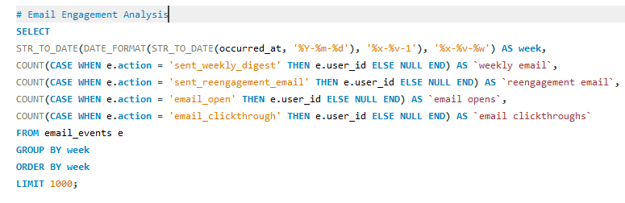
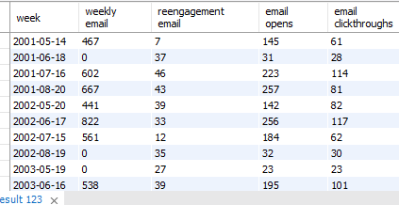
Email Engagement Analysis
DATA ANALYSIS

Slide 25
INSIGHTS Case Study 1: Job Data Analysis
Jobs Reviewed Over Time
Duplicate Rows Detection
Identified presence of duplicate records and highlighted the need for data cleaning and deduplication to ensure analysis accuracy.
Observed daily and hourly variations in review activity, indicating peak operational hours and weekdays generally had higher review volumes than weekends.
joB DATA ANALYSIS
Throughput Analysis
7-day rolling average provided a smoother, more reliable trend by filtering daily fluctuations and identified days with lower throughput that may signal workflow inefficiencies or system slowdowns.
Language Share Analysis
English dominated job language share and non-English languages had minor shares, suggesting potential localization opportunities.

Slide 26
INSIGHTS Case Study 2: Investigating Metric Spikes
Email Engagement Analysis
Weekly User Engagement
Engagement spiked post-signup but declined over subsequent weeks, suggesting weak long-term retention devices like mobile showed higher engagement compared to desktop.
Low open and clickthrough rates observed and re-engagement emails performed worse than weekly digests, suggesting a need to optimize content and targeting.
User Growth Analysis
Showed steady weekly growth in user signups abd some weeks experienced noticeable surges, possibly due to marketing efforts or product updates.
Weekly Engagement per Device
Weekly Retention Analysis
Mobile devices led in weekly activity engagement trends varied by device, indicating user preference and platform-specific experience differences.
Retention dropped significantly after the first week (Week 0 to Week 1) and indicated the need for improved onboarding and engagement strategies.

Slide 27
Project Achievements & Learnings
RESULTS
DATA ANALYSIS
Through this project, I strengthened my ability to derive actionable insights using advanced SQL and real-world datasetsas well as effectively analyzed user behavior, engagement trends, and operational efficiency, simulating the role of a Lead Data Analyst.
Operational Insight
Learned to monitor and explain metric fluctuations using techniques like rolling averages and cohort analysis.
User Behavior Analysis
Gained deeper understanding of user retention, growth patterns, and the impact of email communication.
Decision Support
Developed data-driven approaches to support marketing, product, and support teams in making informed decisions.

